Slide 1
ROCKBUSTER STEALTH LLC Analysis for 2020 Company Strategy
Jeong Park

Slide 2
Objective
The following questions were addressed in the data analysis to gain actionable insight that can be used for the 2020 company strategy.
What was the average rental duration for all videos?
Which movies contributed the most/least to revenue gain?
Where are customers with high lifetime value based?
Which countries are Rockbuster customers based in?
Do sales figures vary between geographic regions?

Slide 3
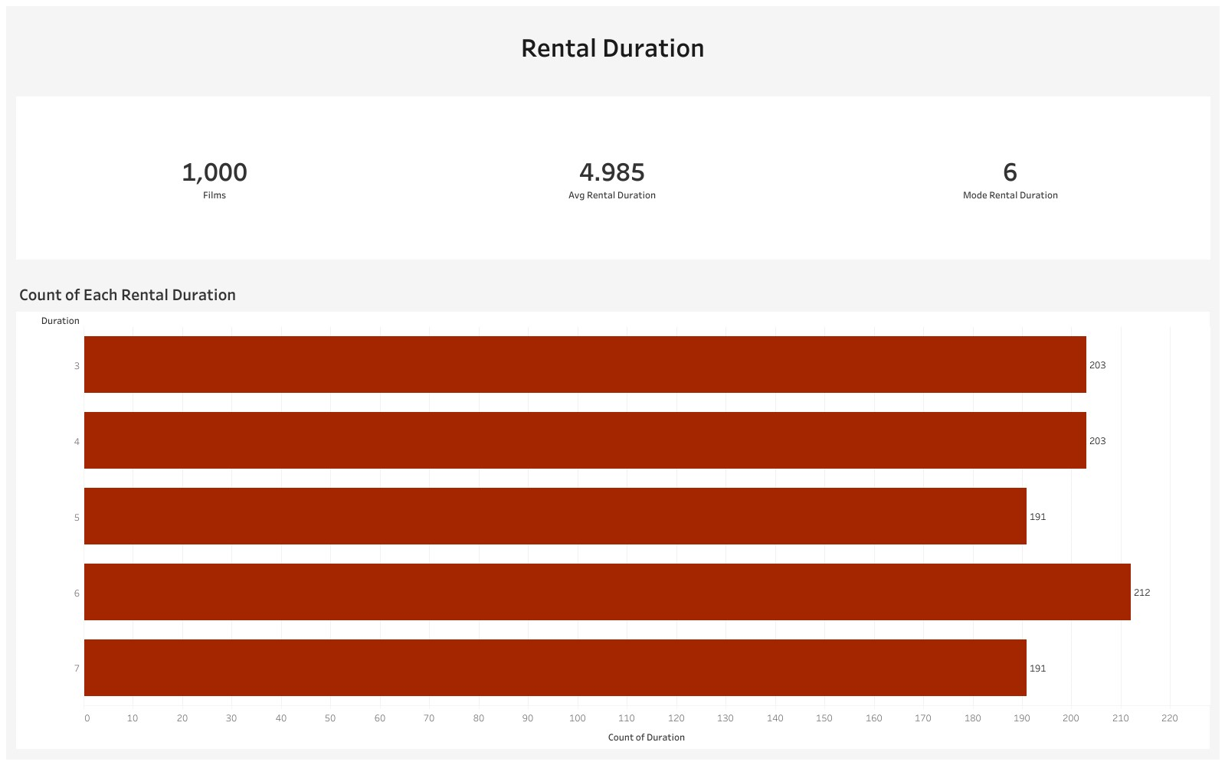

Slide 4
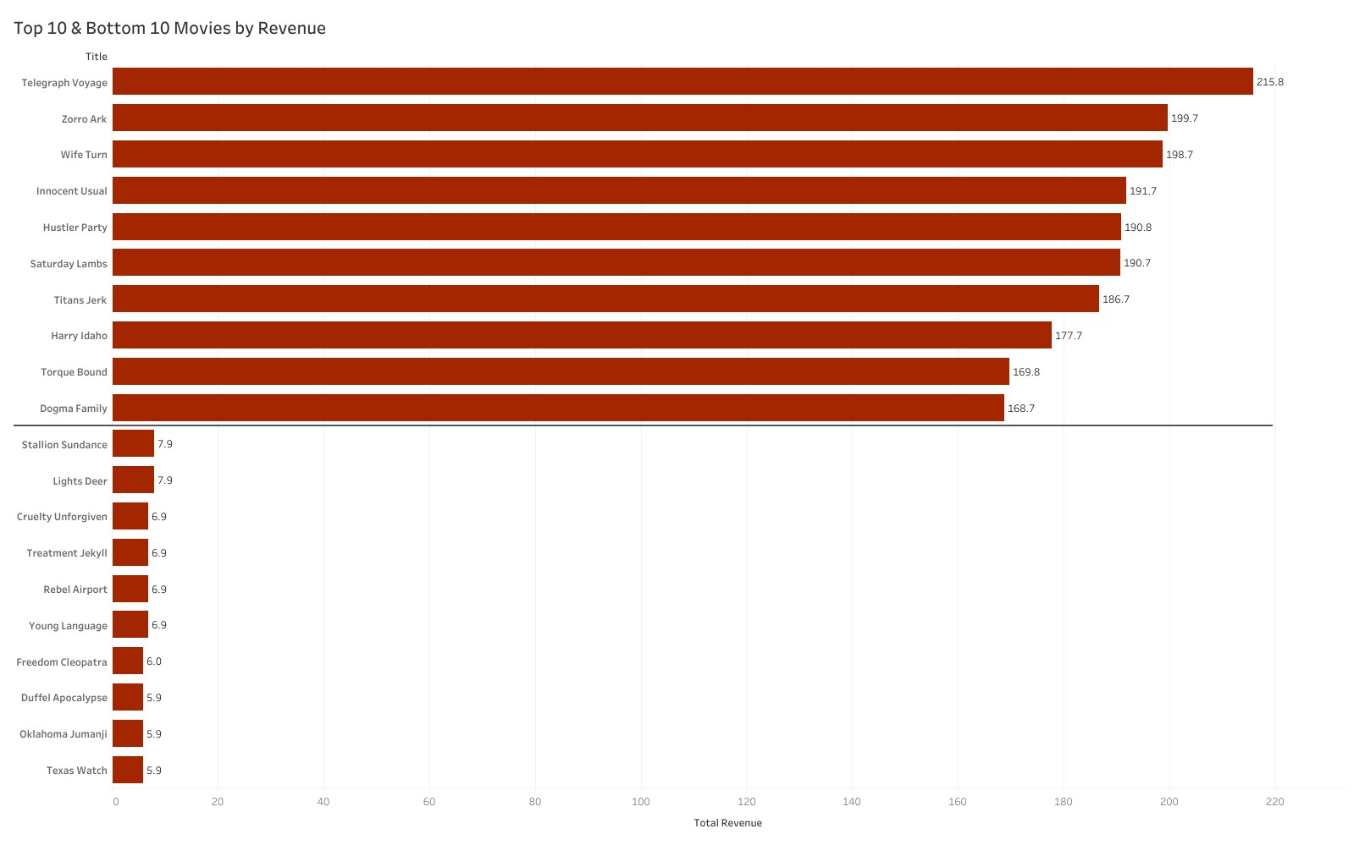
Top and Bottom Movies by Revenue
The average revenue for the top 10 movies is $189.04, around 0.3% of total revenue
Top 10 Movies
The average revenue for the bottom 10 movies is $6.71, around .01% of total revenue
Bottom 10 Movies
The top ten movies made about 30 times the revenue made by the bottom ten movies

Slide 5
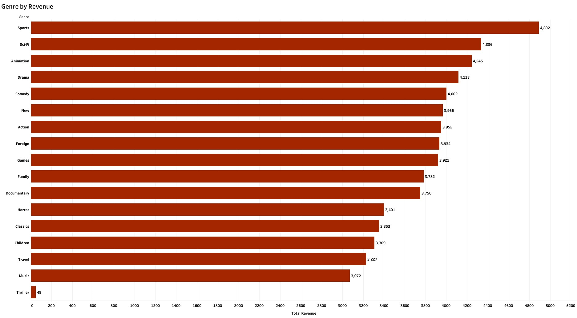
Movie Genres by Revenue
The sports genre brings in the most revenue at $4,892.
Meanwhile, the Thriller genre brings in a negligible amount of $48.

Slide 6
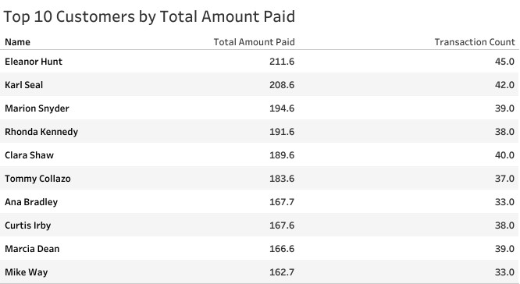
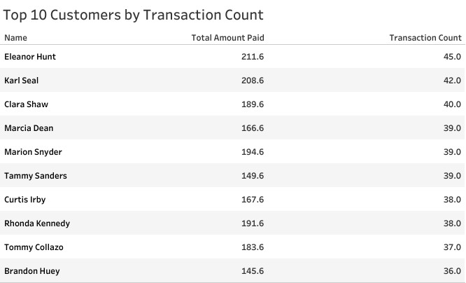
High Lifetime Value Customers
High lifetime value customers were determined by two measures, the total amount that they paid and the number of transactions that they completed.
Through the two tables we can see most of the customers who paid the most also had the most transaction counts except for two, Ana Bradley and Mike Way

Slide 7
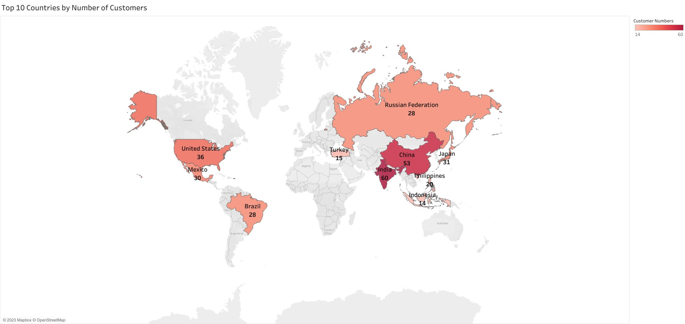
Countries With the Most Customers
Countries in Asia and the Americas have the greatest number of customers

Slide 8
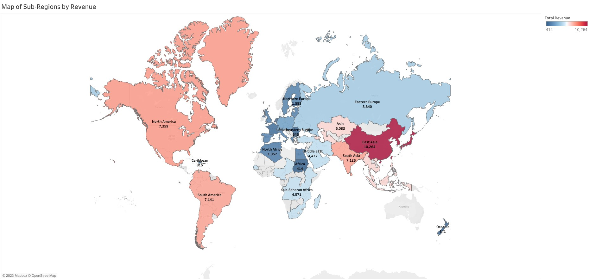
Sub-Regions of Countries by Revenue
Through the map we can see that East Asia brings in the most revenue and is followed by other Asian sub-regions and the American sub-regions
Meanwhile other sub-regions, when grouped in regions make up similar revenue of Asian or American sub-regions.

Slide 9
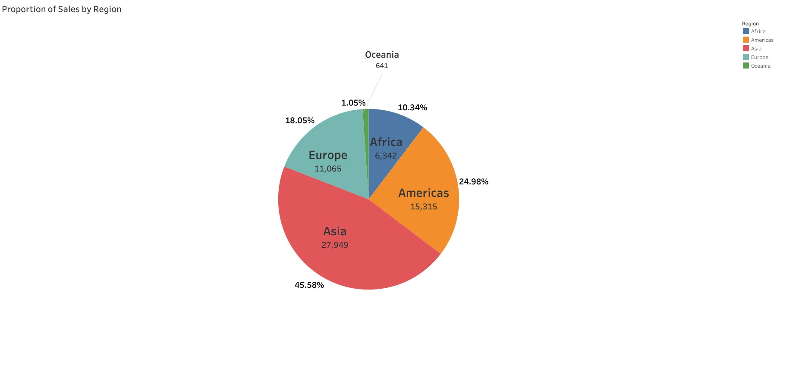
Proportion of Total Global Revenue by Region
Proportion of Total Revenue by Region
We can see that Asia is responsible for almost half, 45.58% of total revenue from all regions.
Interestingly, the difference in the proportion of total revenue between Asia and the Americas was larger than expected at around 20%.
Meanwhile the difference between Americas and Europe was smaller than expected at around 7%.

Slide 10
Conclusion & Recommendations
Key Takeaways
Sports, Sci-fi, and Animation, to name a few, are the genres that bring in the most revenue.
The thriller genre contributed an insignificant amount of revenue. Upon further analysis, we found that while other genres had between 50-70 movies, thriller only had 1.
Countries in Asia and the Americas had the most customers, with India having the most overall and the United States having the most in the Americas.
Asia accounts for nearly 50% of the total revenue. It accounts for 20% more in revenue than the following region, the Americas.
Recommendations
Increase selection and inventory within popular genres, such as Sports, Sci-Fi and Animation. Additionally, due to lack of data we cannot determine the popularity of the Thriller genre. Therefore, the selection and inventory of this genre should be increased as well and adjusted after according to the revenue it brings.
Resources should be focused primarily on Asia as it is the region in which Rockbuster has shown the most success. Furthermore, India and China have the most customers. Therefore, Rockbuster should work to retain and increase their customer base in these countries.
For other regions, Rockbuster should look to increase customer base and satisfaction through further analysis. Especially in America and Europe, as they are the next biggest regions in terms of revenue and the difference between the two is not as significant as the other regions.

